Slide 1
Social Media Analytics
Topic 8: Online Reputation Management – Tapping in to Focus Interest Groups

Slide 2
Learning Objectives
Defining influence online
Cultivating relationship with influencers
Individual influencers
Discovering community groups on larger social networks
Exploring review sites

Slide 3

Defining Influence Online
The most powerful thing to promote and insulate Online Reputation is to recognize that all online activity is really about interacting with audiences of audiences

Slide 4
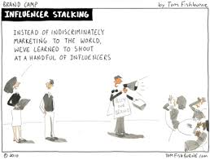
Defining Influence Online
Cultivate audience that can’t wait to talk with you about the lasting thing that you’ve posted
Aim for engagement

Slide 5
Defining Influence Online
Influence score fluctuates pretty rapidly
Need to look at larger time interval to get average score
Going vocation can be disastrous
Influence score may not mirror reality
Blog, social network and forum comments are the most influential influence-measuring sites because they demonstrate whether somebody is really engaging and influencing others

Slide 6
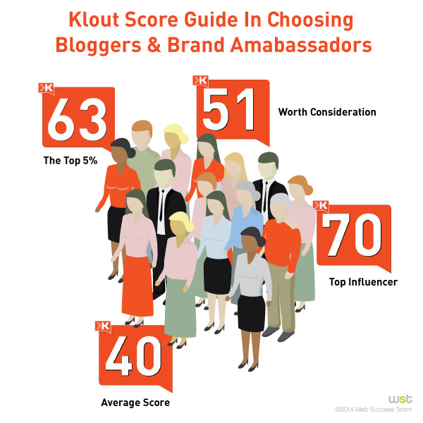
Defining Influence Online – Examples of influential rating service
Klout – http://klout.com/home
Link to the user’s social media platforms such as Twitter, LinkedIn, Facebook profile and Google+
Evaluate the user involvement on the social media platforms and apply the score accordingly
www.business2community.com

Slide 7
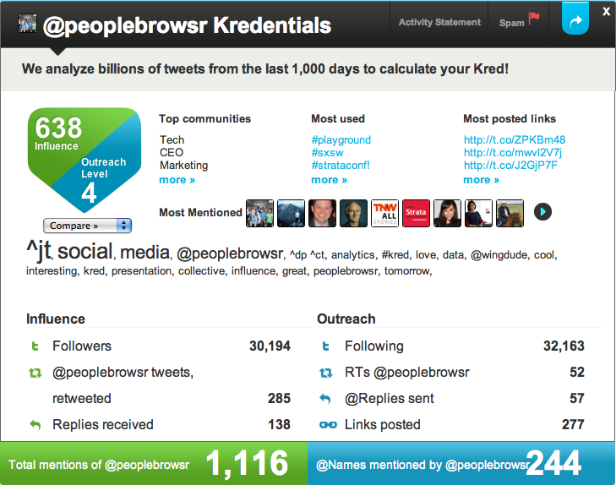
Defining Influence Online – Examples of influential rating service
Kred – http://www.kred.com/home
Besides evaluates the influence and outreach level, Kred is allowed the user to meet and network with other influencers
lonelybrand.com

Slide 8
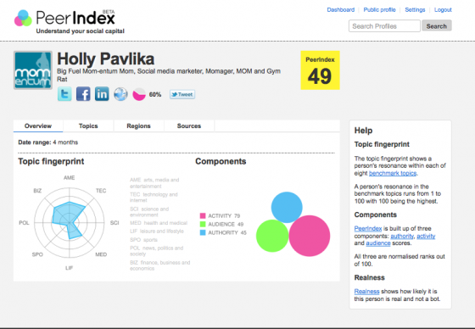
Defining Influence Online – Examples of influential rating service
PeerIndex – http://www.peerindex.com
Break down influence into the following:
Authority – measure trust, calculate no of rely on your recommendations and opinion for a topic
Audience – Audience score is a normalized indication of your reach
Activity – measure how much you do that is related to the topic communities you are part of

Slide 9

Cultivating relationship with influencers
Youtube – by PR Newswire

Slide 10
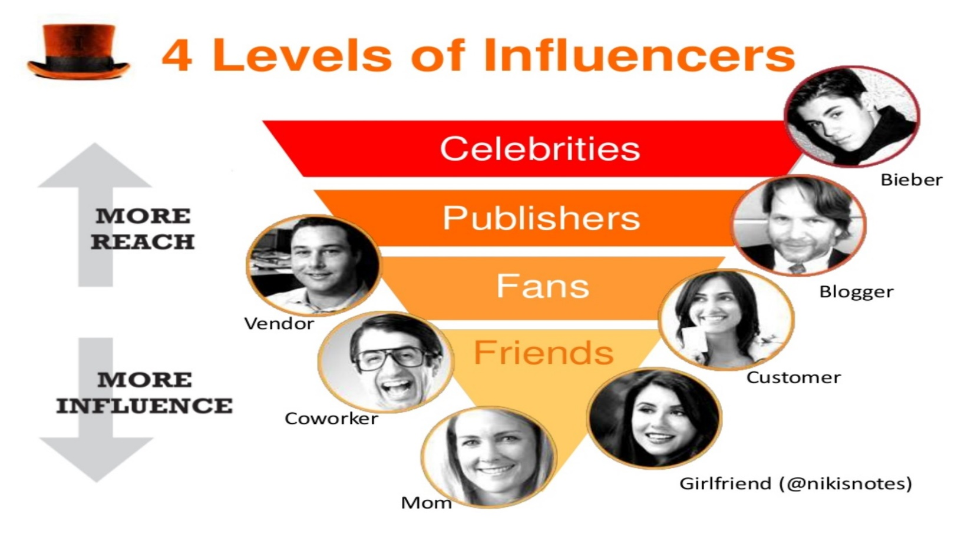
Individual Influencers
Influencers can come from multiple and varied industries
Coolerinsights.com

Slide 11
Individual Influencers
More Reach
Celebrities charm, entertain, or otherwise capture people’s attention
Publisher such as bloggers are experts in a given field
More influence
Fans and Friends are trusted resources for news, tips, or technical know-how

Slide 12
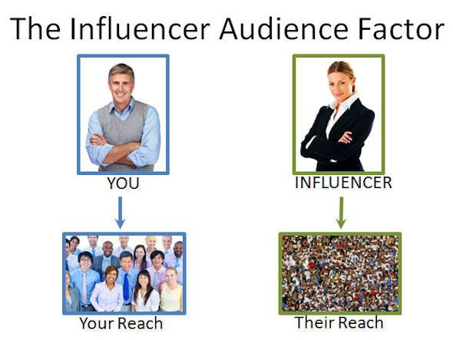
Individual Influencers – How to spot them?
Read/View that person’s material
Check blog traffic, subscriptions, or search-engine rankings to get a sense of how often people are visiting that person’s site or blog
Influencer marketing

Slide 13
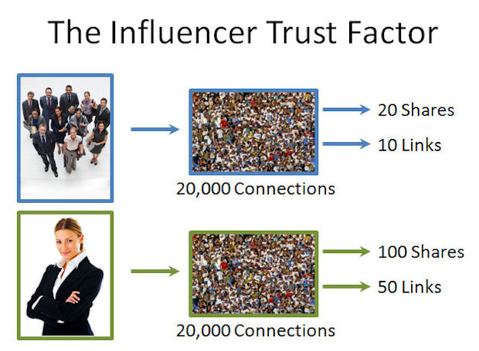
Individual Influencers – How to spot them?
Response to that person’s posts
Check Likes on Facebook, plusses on Google+, and comments on any blog, forum, or social network
Shares or Reposts of that person’s material
Influencer marketing

Slide 14
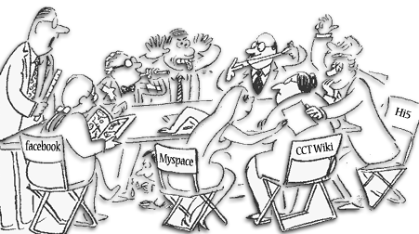
Discovering community groups on larger social networks
Gold mine
Groups of expertise getting together to discuss on forum or chat rooms
You can find these interest groups from LinkedIn groups, Facebook and Google+

Slide 15
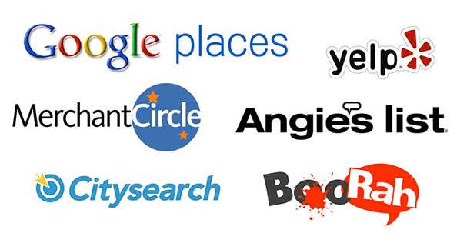
Exploring review sites
Trusted resources for buying decisions
To obtain more objective content
Limitless variety of opinions
Sincere results testimonials
Help to establish positive reputation by paying attention to review sites periodically

Slide 16
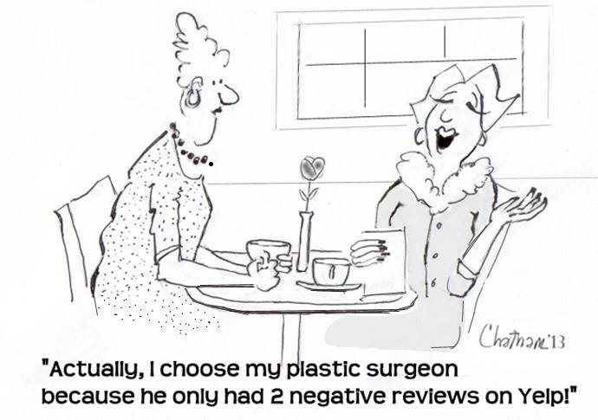
Exploring review sites
Examples:
Angie’s List – Online consumer-reporting community
Yelp – Online urban city guide that helps people find cool places to eat, shop and drink.

